Slide 1






SQL Server for Developers
Using SQL Server, DB Design, SQL SELECT, INSERT, UPDATE, DELETE
SQL Server
SQL
SoftUni Team
Technical Trainers
Software University
http://softuni.bg

Slide 2



Table of Contents
SQL Server Overview
Installing LocalDB and SSMS
Creating DB Diagrams in SSMS
Creating Blog DB: Users, Posts, Comments, Tags
Introduction to SQL
SELECT, WHERE, JOIN
Aggregate Functions and GROUP BY
INSERT, UPDATE, DELETE

Slide 3
Have a Question?
sli.do #8575

Slide 4
MS SQL Server – Overview

Slide 5
What is SQL Server?
Microsoft SQL Server
SQL Server is enterprise DB server (RDBMS)
Widely used in the Microsoft ecosystem
For Web apps and enterprise apps
Free editions
SQL Express and SQL LocalDB
Paid editions
SQL Standard, SQL Enterprise

Slide 6
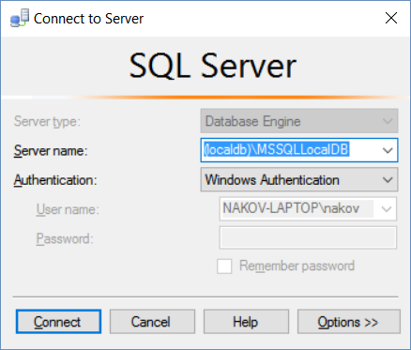
Installing SQL Server LocalDB and SSMS
SQL Server LocalDB is free lightweight version of SQL Server
It starts automatically on connect request (no service start / stop)
Install MS SQL Server 2016 Express LocalDB
https://www.microsoft.com/en-us/download/confirmation.aspx?id=52679
Install SQL Server Management Studio (SSMS)
Use June 2016 version (July 2016 is broken!)
http://go.microsoft.com/fwlink/?LinkID=799832

Slide 7
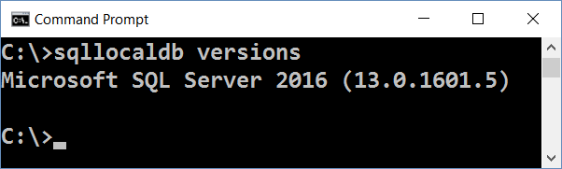
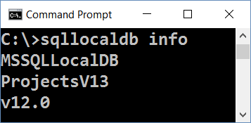
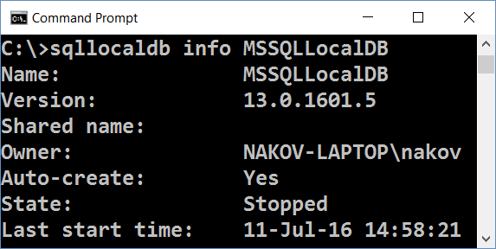
Checking for SQL Server LocalDB
Check whether you already have SQL Server LocalDB installed
Start Command Prompt
List all LocalDB versions:
List LocalDB instances:
sqllocaldb versions
sqllocaldb info
sqllocaldb info MSSQLLocalDB

Slide 8
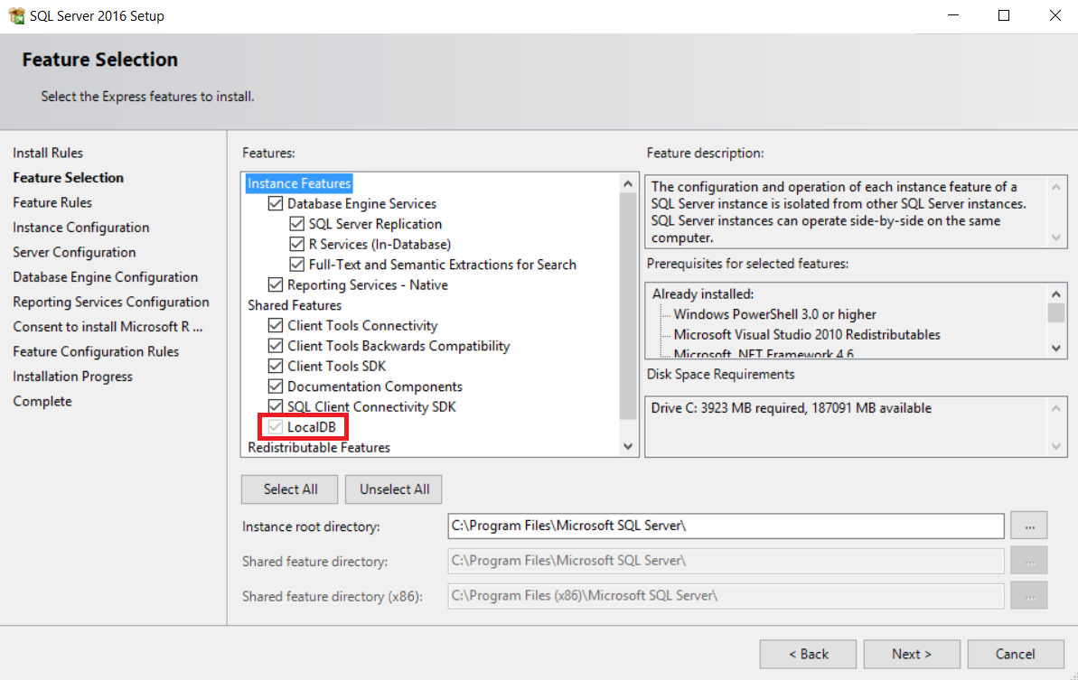
Installing SQL Server 2016 LocalDB

Slide 9
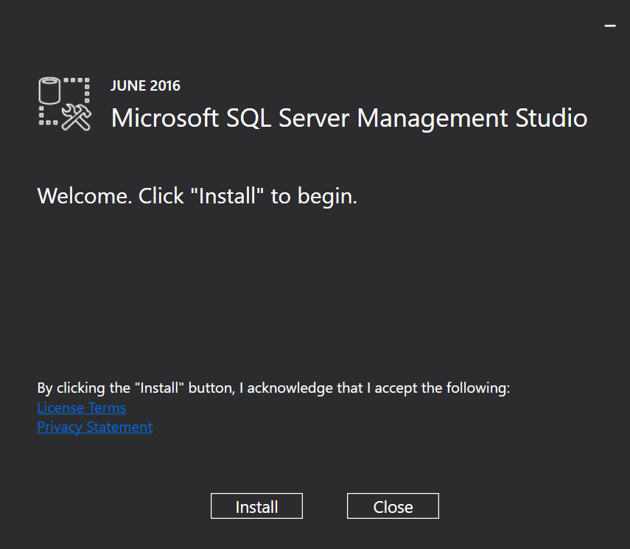
Installing SQL Server Management Studio

Slide 10
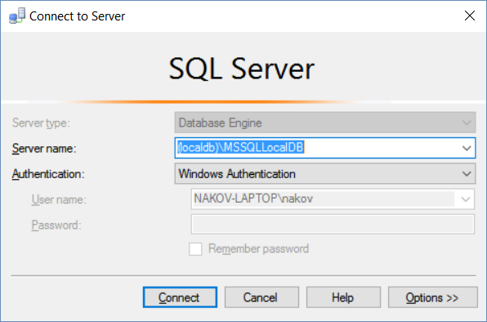
Connecting to SQL Server LocalDB 2016

Slide 11
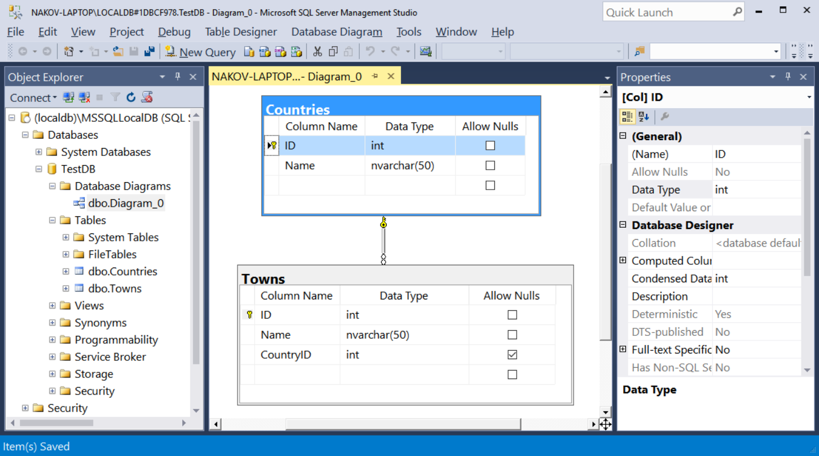
SQL Server Management Studio (SSMS)

Slide 12
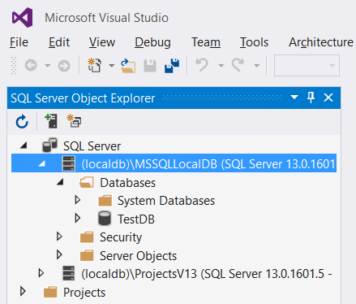
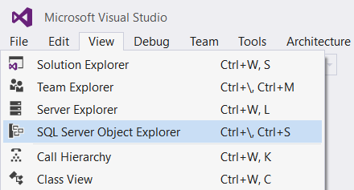
SQL Server Data Tools for Visual Studio (SSDT)
Install SQL Server Data Tools for Visual Studio (SSDT): http://go.microsoft.com/fwlink/?LinkID=817260
Use the SQL Server Object Explorer

Slide 13
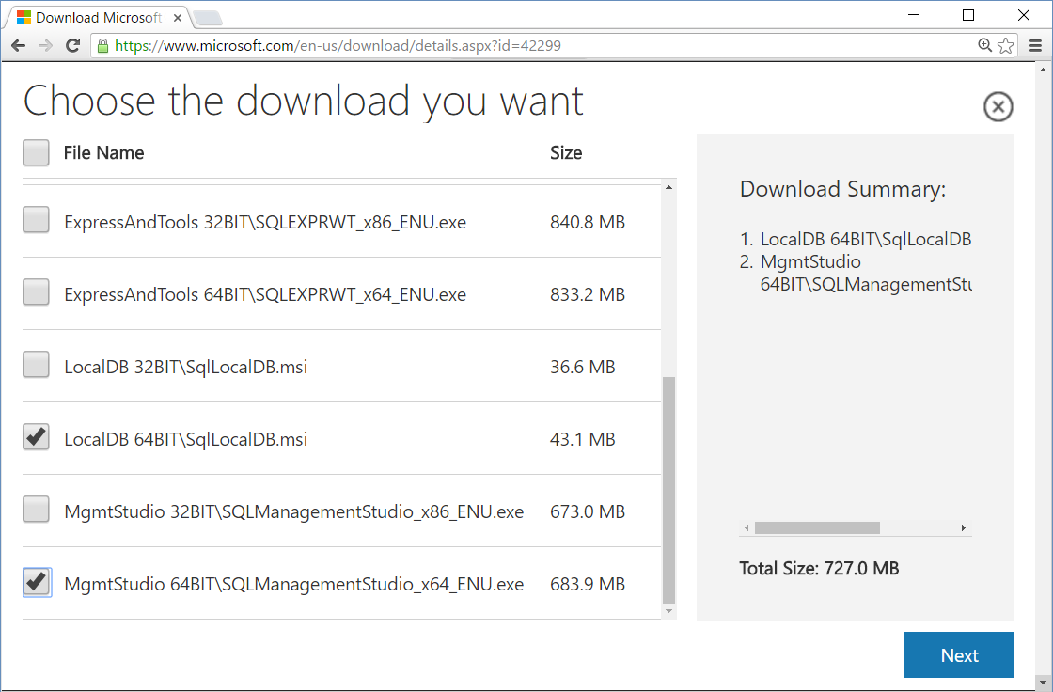
Emergency Setup: SQL Server 2014
SQL Server Express 2016 requires Windows 8 or later
In Windows 7 use SQL Server 2014 instead
Installing SQL Server 2014 LocalDB (and SSMS 2014)
https://www.microsoft.com/ en-us/download/details.aspx ?id=42299
SSMS 2016 works on Win7 and supports SQL 2014

Slide 14
Install and Connect to SQL Server
Live Exercise in Class (Lab)

Slide 15
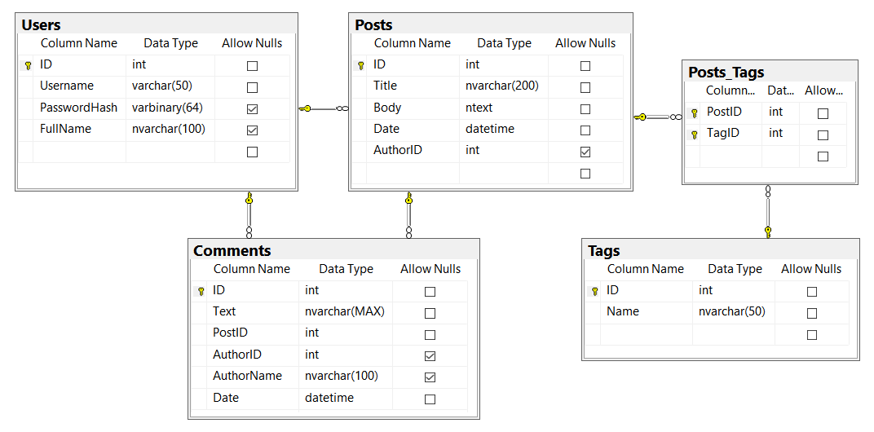
Creating Database Diagrams in SQL Server

Slide 16
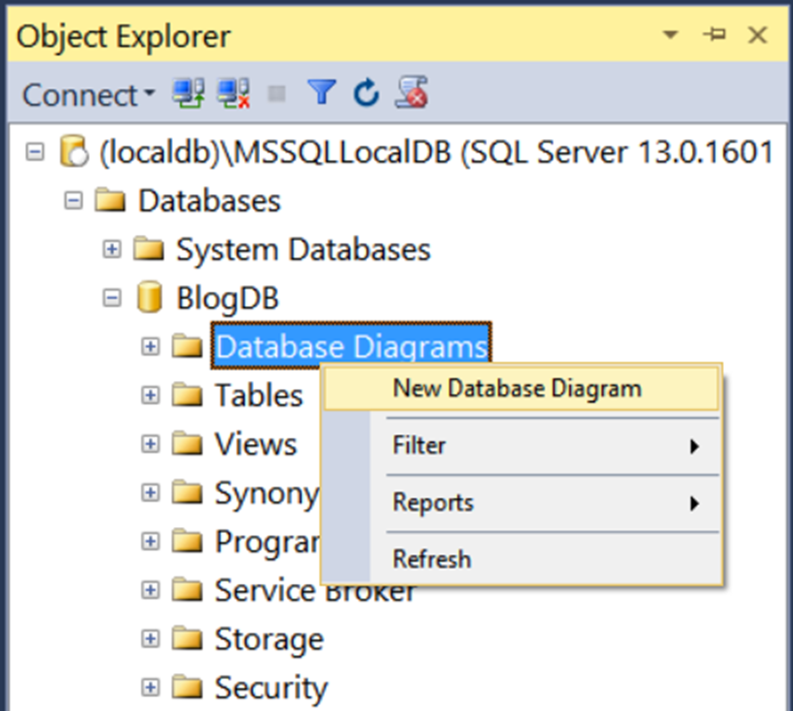
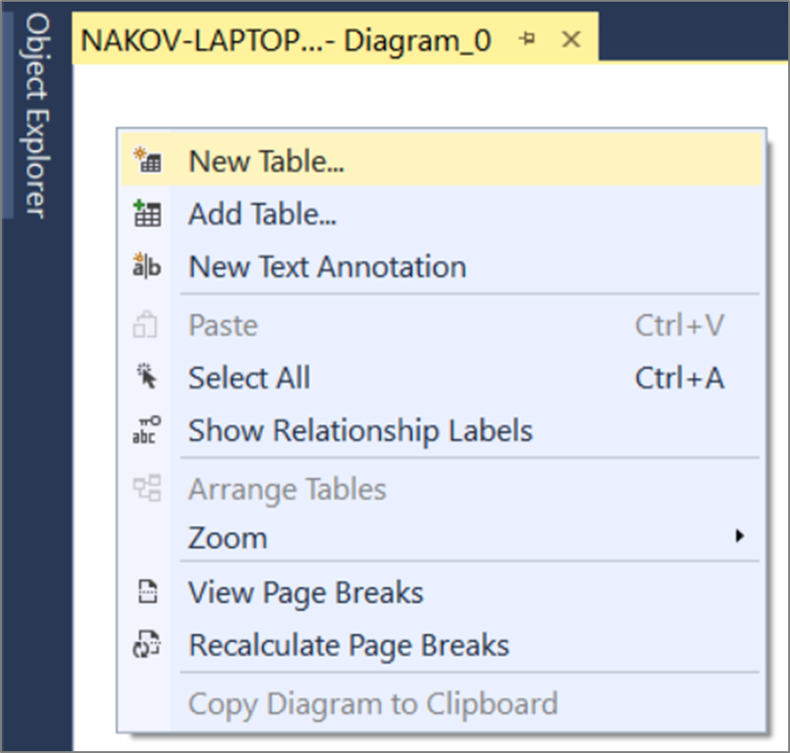
Creating DB Diagrams in SSMS

Slide 17
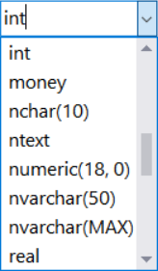
Data Types in SQL Server
Numeric types
bit, int, float, money, numeric(scale, precision)
Text types
char(size), varchar(size) / nvarchar(size), text / ntext
Date and time
datetime, smalldatetime
Binary data
varbinary(size), image (large binary object)

Slide 18
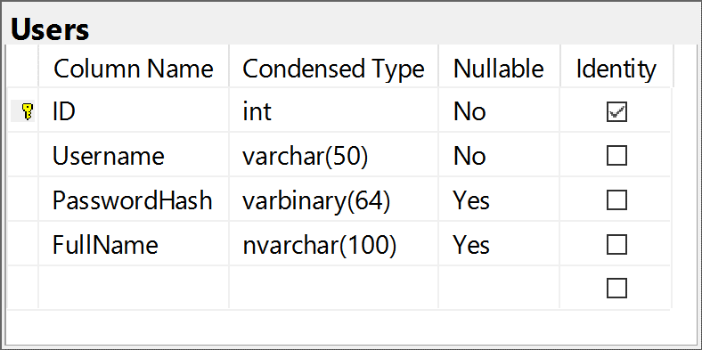
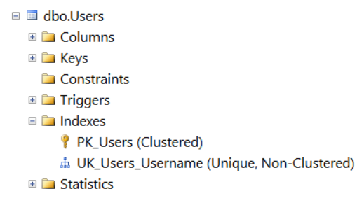
Users Table
Users table holds blog users (authors)
ID + Username + PasswordHash (binary data) + FullName
ID is primary key and identity (auto-increment)
Unique index UK_Users_Username(Username)

Slide 19
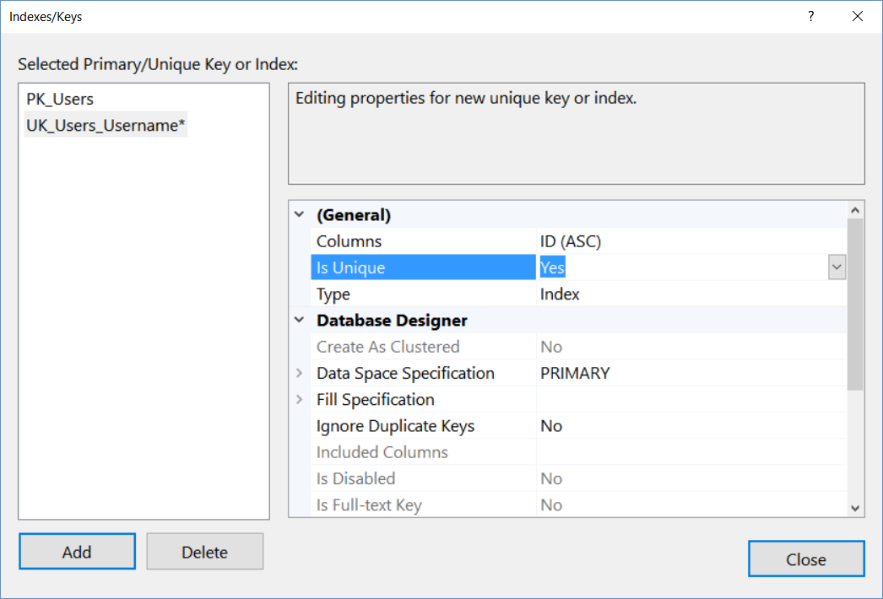
Create Unique Index: Users(Username)

Slide 20
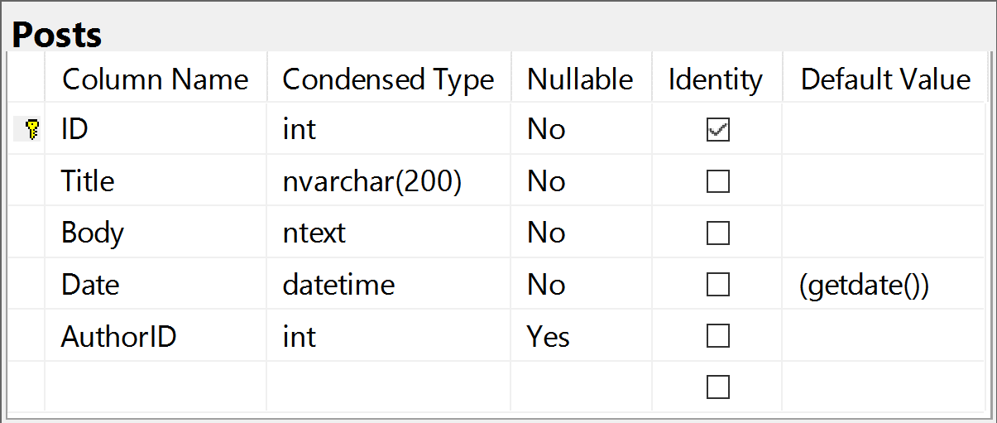
Posts Table
Posts table holds blog posts (publications)
ID + Title + Body + Date + AuthorID (optional)
The AuthorID is a foreign key to Users(ID)
The Date column is auto-filled by the current date and time

Slide 21
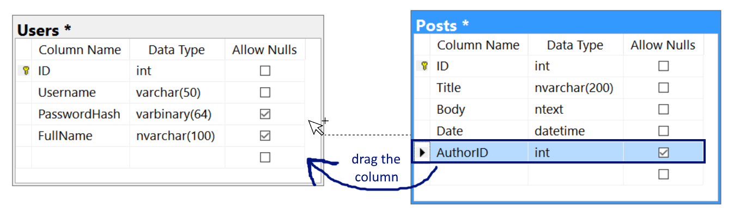
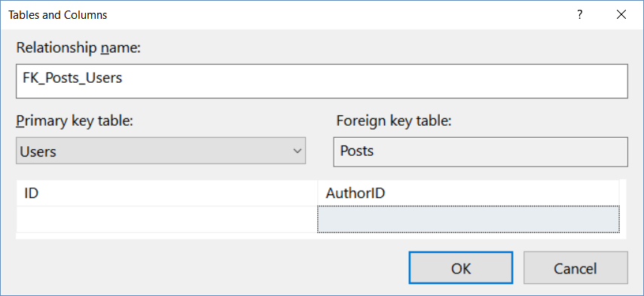
Creating Foreign Key: Users to Posts

Slide 22
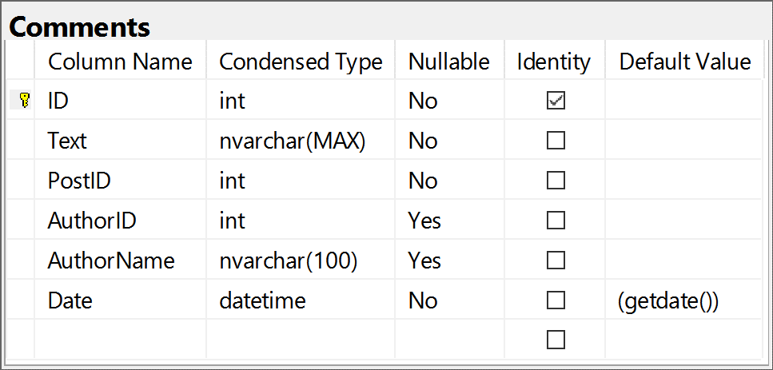
Comments Table
Comments table holds post comments
ID + Text + PostID + AuthorID or AuthorName + Date
AuthorID is a foreign key to Users(ID)
PostID is foreign key to Posts(ID)
Either AuthorID or AuthorName is used
The Date column is auto-filled by the current date and time

Slide 23
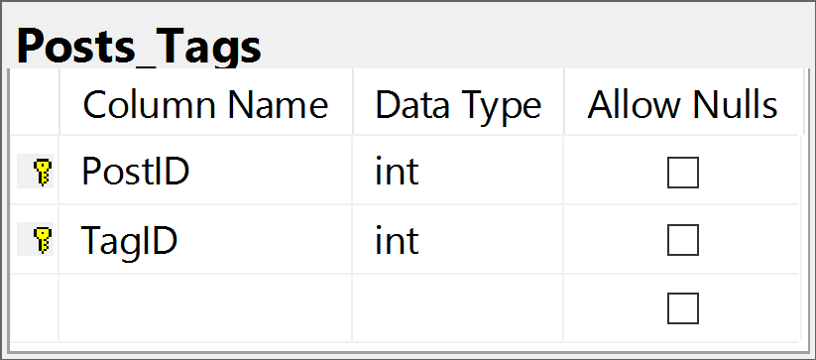
Tags and Posts_Tags Tables
Tags table holds post tags
ID (primary key, identity)
Name (Unicode text)
Posts_Tags table connects post to tags
PostID – foreign key to posts
TagID – foreign key to tags
Composite primary key (PostID and TagID are unique together)

Slide 24
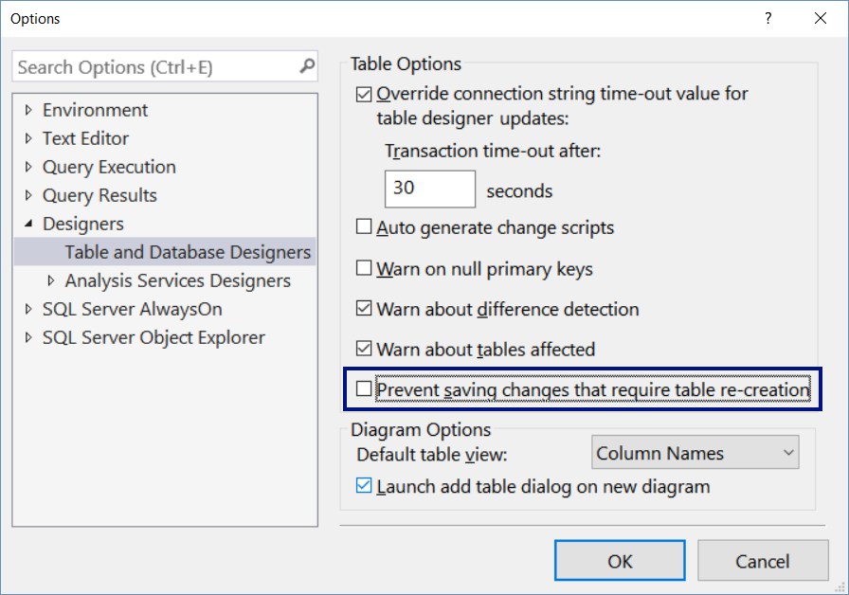
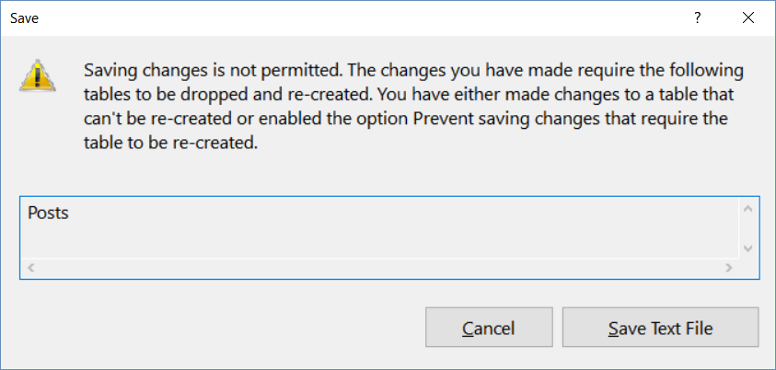
Configure the Management Studio

Slide 25
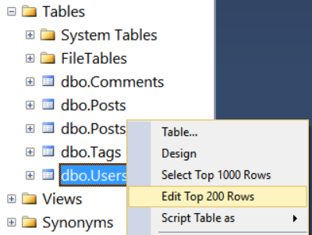
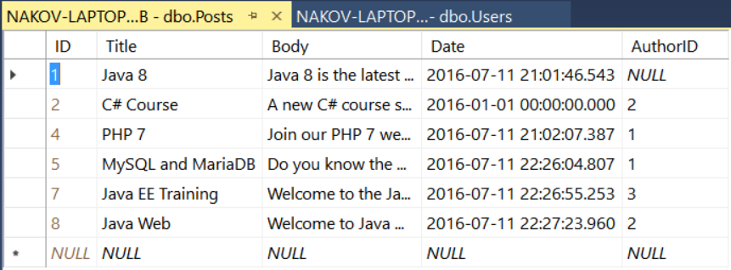
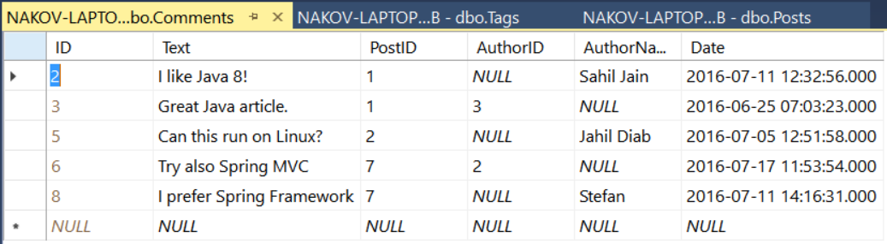
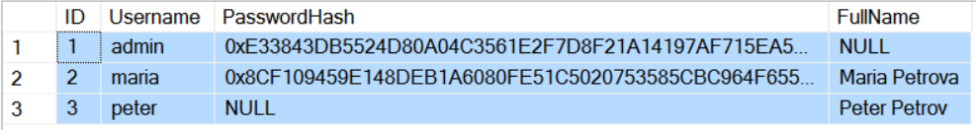
Fill Sample Data

Slide 26
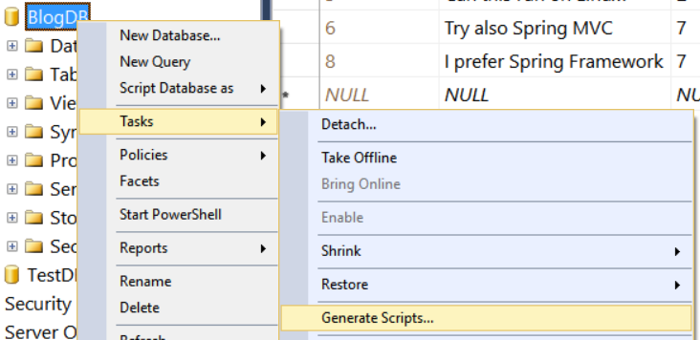
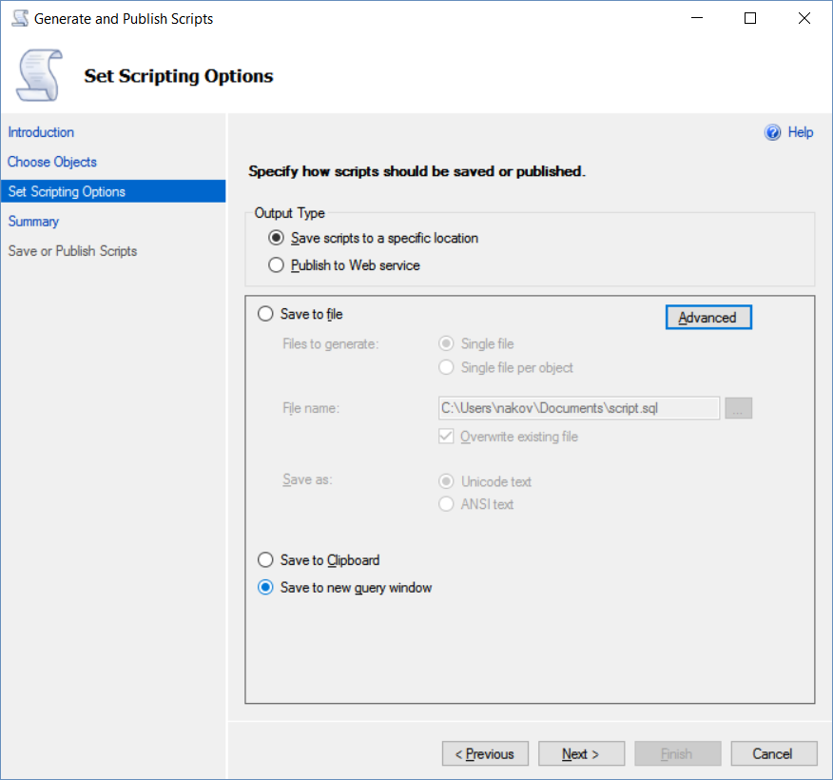
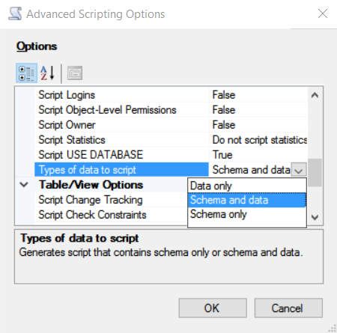
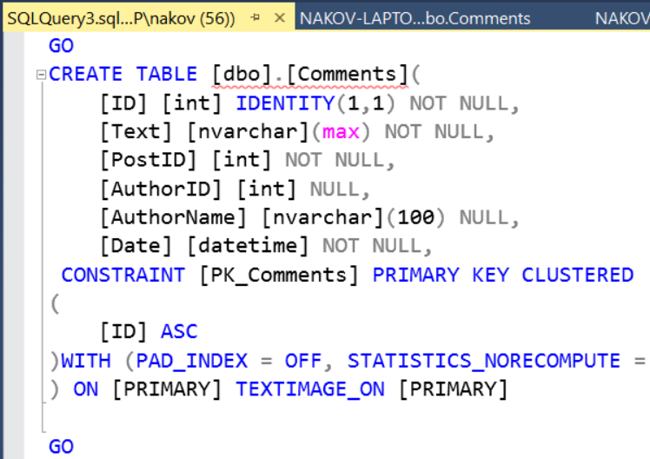
Export Database as SQL Script

Slide 27
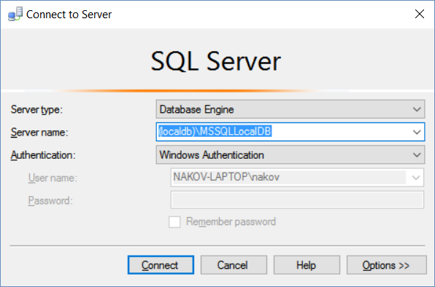
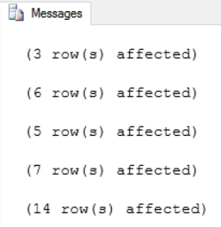
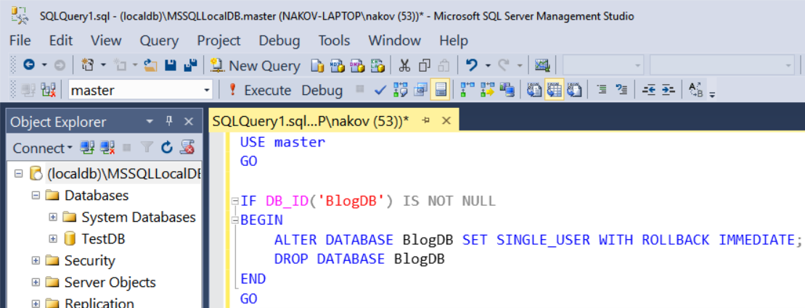
Import Database from SQL Script
Connect to the database server
Open SQL query window
Paste the SQL script code
Click the [Execute] button

Slide 28
Create BlogDB Database Schema
Live Exercise in Class (Lab)

Slide 29

SQL Language
SQL is standardized language for relational databases
Data manipulation language (DML)
Search / modify table data rows
SELECT, INSERT, UPDATE, DELETE
Data definition language (DDL)
Define / modify database schema
CREATE, ALTER, DROP
Permission commands
GRANT, DENY, REVOKE

Slide 30
SQL SELECT, WHERE, ORDER BY
SELECT
WHERE
ORDER BY
SELECT * FROM Posts
SELECT Username, FullName
FROM Users
SELECT * FROM Users
WHERE ID = 2
SELECT * FROM Users
WHERE FullName >= 'M'
SELECT * FROM Users
ORDER BY Username
SELECT TOP 3 * FROM Users
ORDER BY FullName DESC

Slide 31
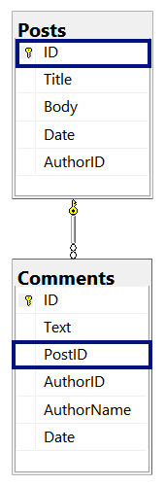
Join Tables
Join Posts with Comments tables
SELECT
p.ID as PostID, p.Title,
c.ID as CommentID, c.Text, c.Date
FROM Posts p
JOIN Comments c ON p.ID = c.PostID

Slide 32
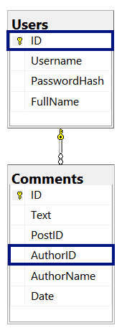
Join Tables with Filtering and NULL Check
Join Comments with Users tables in order to correctly display the comment author name
SELECT
c.ID AS CommentID, c.Text AS CommentText,
ISNULL(u.FullName, c.AuthorName) AS Author
FROM Comments c
LEFT JOIN Users u ON c.AuthorID = u.ID
WHERE PostID = 1

Slide 33
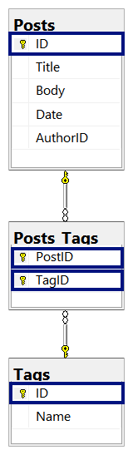
Join Multiple Tables
Join the Posts with Tags (many-to-many relationship)
SELECT
p.ID AS PostID, p.Title,
t.ID AS TagID, t.Name
FROM Posts p
JOIN Posts_Tags pt ON p.ID = pt.PostID
JOIN Tags t ON pt.TagID = t.ID

Slide 34
Aggregate Functions and Grouping
Aggregate functions calculate value over multiple rows
COUNT(…), MIN(…), MAX(…), SUM(…),
SELECT MIN(Date) FROM Comments
SELECT COUNT(*) AS [Comments Count]
FROM Comments
WHERE PostID = 1
SELECT PostID, COUNT(ID) AS CommentsCount
FROM Comments
GROUP BY PostID

Slide 35
Nested SELECT
SELECT
DISTINCT p.ID as PostID, p.Title
FROM Posts p
JOIN Posts_Tags pt ON p.ID = pt.PostID
WHERE pt.TagID IN
(SELECT ID FROM Tags
WHERE Name IN ('programming', 'Web'))
ORDER BY p.Title

Slide 36

SQL INSERT
Insert a new post (id and date will be auto-generated)
Insert a few new users
INSERT INTO Posts(Title, Body, AuthorID)
VALUES ('New Title', 'New post content', 3)
INSERT INTO Users(Username, PasswordHash) VALUES
('joe', HASHBYTES('SHA2_256', 'P@$$@123')),
('jeff', HASHBYTES('SHA2_256', 'SofiA!')),
('poly', HASHBYTES('SHA2_256', 'p@ss123'))

Slide 37


SQL UPDATE
Update existing post → change title
Update existing post → change date
UPDATE Posts
SET Title = 'Title Updated!'
WHERE ID = 2;
UPDATE Posts
SET Date = '2016-05-29T23:51:00'
WHERE YEAR(date) = 2016;

Slide 38


SQL DELETE
Delete existing post by ID
Delete all comments from user 'maria'
DELETE FROM Posts
WHERE ID = 9;
DELETE FROM Comments
WHERE AuthorID =
(SELECT ID FROM Users
WHERE Username = 'maria');

Slide 39
T-SQL – Improved SQL
Transact SQL (T-SQL) – adds conditions, loops, procedures, etc.
USE master
GO
IF DB_ID('BlogDB') IS NOT NULL
BEGIN
ALTER DATABASE BlogDB
SET SINGLE_USER WITH ROLLBACK IMMEDIATE;
DROP DATABASE BlogDB
END
GO

Slide 40
CREATE / ALTER / DROP
CREATE TABLE Tags(
ID int IDENTITY NOT NULL,
Name nvarchar(50) NOT NULL,
CONSTRAINT PK_Tags PRIMARY KEY (ID))
ALTER TABLE Comments ADD CONSTRAINT DF_Comments_Date DEFAULT GETDATE() FOR Date
DROP TABLE Tags

Slide 41

Summary
SQL Server is enterprise database system
Relational database: tables with relationships
LocalDB – free lightweight SQL Server version
Install SQL Server
SQL LocalDB + Management Studio (SSMS)
The SQL language
Query data: SELECT, WHERE, JOIN, GROUP BY
Modify data: UPDATE, DELETE, INSERT

Slide 42








SQL Server for Developers
https://softuni.bg/courses/software-technologies

Slide 43
License
This course (slides, examples, demos, videos, homework, etc.) is licensed under the "Creative Commons Attribution-NonCommercial-ShareAlike 4.0 International" license

Slide 44






Free Trainings @ Software University
Software University Foundation – softuni.org
Software University – High-Quality Education, Profession and Job for Software Developers
softuni.bg
Software University @ Facebook
facebook.com/SoftwareUniversity
Software University @ YouTube
youtube.com/SoftwareUniversity
Software University Forums – forum.softuni.bg

